Slide 1


Lecture 4:
Linear and Logistic Regression
McGill Artificial
Intelligence Society

Slide 2
Today’s Agenda
Linear Regression
Optimization Via Gradient Descent
Logistic Regression
Multinomial Regression

Slide 3
Recall two main types of supervised algorithms
Regression:
Input maps directly to a continuous output space
Involves estimating or predicting a response
Ex: predicting housing prices, computing trends in stock market
Classification:
Input maps to a class label
Classification is the act of identifying group membership
Ex: image classification, semantic classification in text
Notes:
In order to dig into the fundamentals of machine learning, we’ll be investigating the properties of two supervised learning algorithms: one regression algo, and one classification algo. (ask class to tell the difference) So today, our main focus will lie on linear regression and logistic regression, which counter-intuitively, is actually a classification method. We’ll talk about why it has “regression” in its name though (Slide)

Slide 4
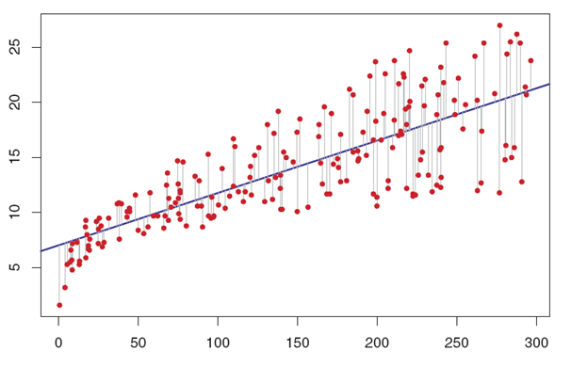
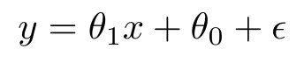
Linear Regression
Algorithm that maps a line of best fit to a set of data points.
Assumption: data is from a linear distribution that contains noise
Image credits to Rachna Devasthali from towarddatascience.com
Notes:
So the bread and butter algorithm that everyone learns is a statistical method we mentioned last class, called linear regression.
Linear Regression basically maps a line of best fit to a set of data points. When do we use linear regression? Before ever choosing a model, we make some basic assumptions about what our data distribution looks like.
What are some of these assumptions?
We are making the assumption that the data is sourced from a distribution that was inherently linear, with the addition of some noise. So, when we say a model is linear, we mean that it is linear with respect to its parameters! The most intuitive case is in 2D, but linear models can involve multiple parameters. Now, since we’re in ML, let’s look at the mathematical notation behind this method. (Slide)

Slide 5
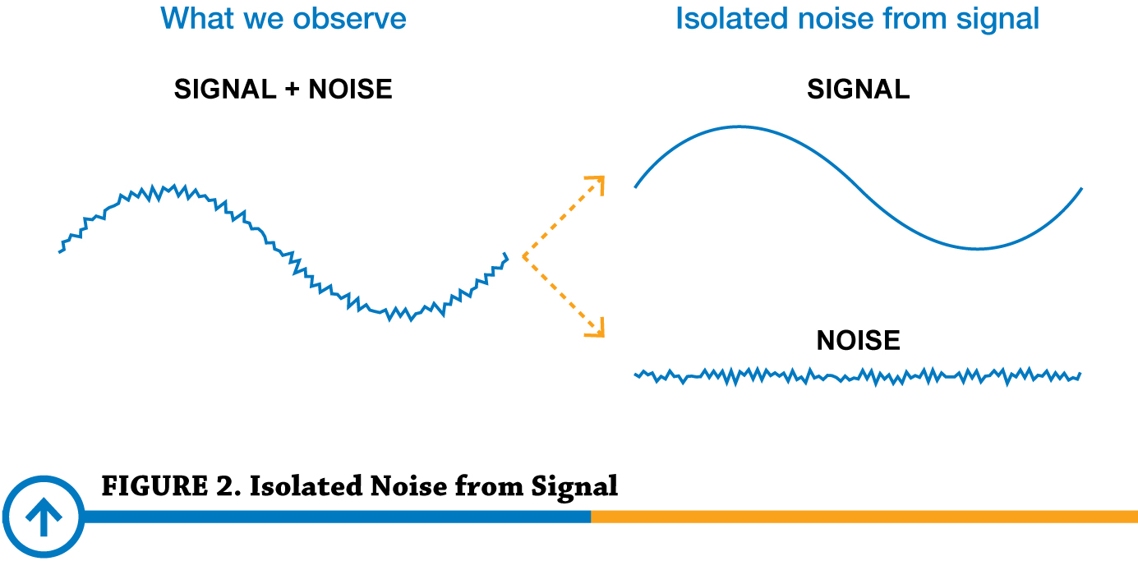
Why is there noise?
Faulty measurements
Uncertainty in measurements
Data corruption
Misinterpretation
Etc.
Picture from Precision Digital Corporation

Slide 6
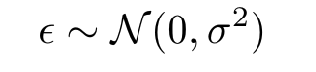
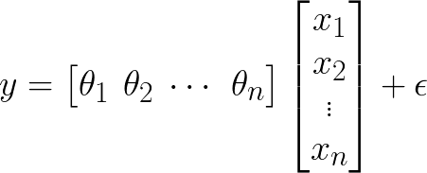
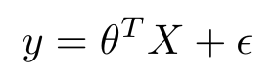
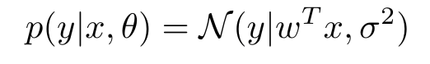
Linear Regression
We begin with the general format of a linear regression problem
Where we model real-world practicalities with standard Gaussian noise
In vector (compact) form, we write:
Probabilistic interpretation:
Notes:
In the first equation, we describe the linear regression problem by its affine structure, with parameters theta. We also have the term epsilon, which is assumed to model standard Gaussian noise applied to to model to account for real-world impracticalities. (Back to prev. slide) (Ask Class about Gaussian distribution).
So the Gaussian PDF, or probability distribution function, is described by 2 parameters: its mean and variance. The N is just notation for a Gaussian. Don’t worry if you can’t visualize it, we’ll be looking at the curve really quickly on the next slide.
Let’s just move on to the following equation, which is really the first one, but written in compact form! We simply have a vector theta, and a vector X, and this is just shorthand notation.
Finally, although Bayesian modeling isn’t within the scope of this course, it’s important to at least be somewhat familiar with probabilistic interpretations, so that if you read academic papers on your own, you won’t be as intimidated. (Explain conditional probability)
Given a dataset with pairs (x_{i}, y_{i}), how do we find θ₁ , θ₀ ?
Make sure to not put too much emphasis on the notation, but rather the idea

Slide 7
Probabilistic Interpretation
Given the dataset and the noise, how likely is each point actually part of the linear function. The closer the point is to the line, the more likely it is part of that linear function.

Slide 8
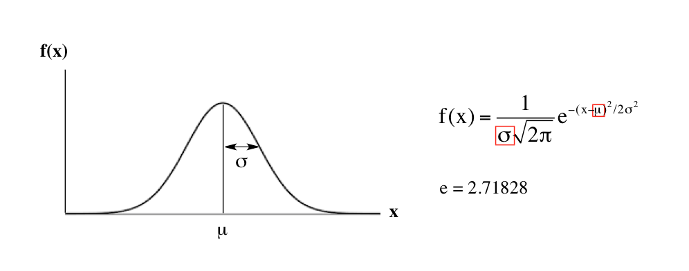
The Gaussian Distribution
Distribution defined by its mean (µ), variance (𝛔)
f(x) = relative likelihood that x is equal to that sample
If you apply this noise to your data:
→ mean: best fit line
→ variance: the deviation of real data points from the best fit line
Notes:
NOTE: this is the PDF (probability density function)
Given a random variable x, a PDF is a function, whose value f(x) at any given sample in the sample space, can be interpreted as a relative likelihood that the random variable would equal that sample.
Now if you apply this idea of Gaussian noise for linear regression, you can imagine the mean being the line of best fit, and the variance describing the deviation of real data points from our line of best fit.

Slide 9
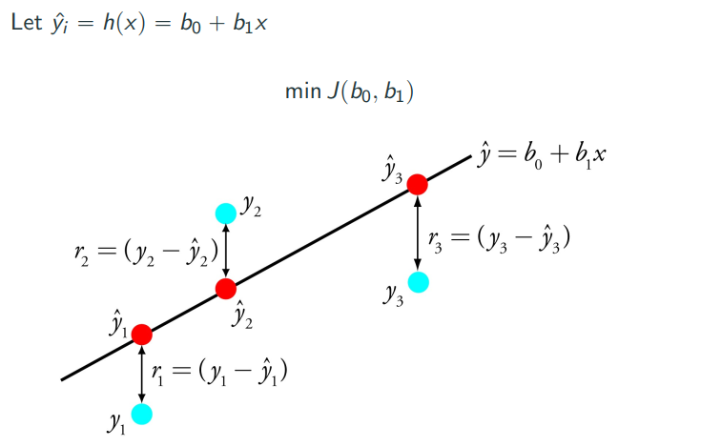
Linear Regression -Least Squares Method
Notes:
Just another graph to visually interpret the sum of squared residuals, denoted here as r. So, how do we minimize this function “J”? (Ask class)
(Slide)

Slide 10
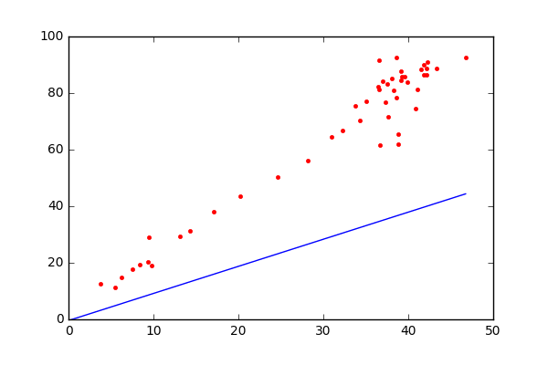
Linear Regression -Least Squares Method
Image credits to Amine Kabab from medium.com
Notes:
Just a visualization depicting the least squares method, defined by our cost function described. We see that the desired solution is the one that minimizes the sum of squared distances to the hypothesized linear function with parameters θ₁, θ₀ (Ask class about RSS vs MSS)
(Slide)
https://cdn-images-1.medium.com/max/1600/1*L9OqETMWSa0zYzrR2t1ZAw.gif → SHOULD BE A GIF. MAKE SURE IT MOVES

Slide 11
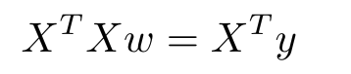
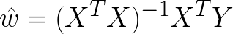
Derivation Least Squares Method
Squared to make sure it’s positive!
Problem with this form: very complex
3 matrix multiplication
1 matrix inverse
Computationally for large datasets with many features / samples
Notes:
Note that the gradient computed is the direction of steepest ascent, so we move towards the negative of the gradient.

Slide 12

Optimization Via Gradient Descent
Goal: descend the error map from the steepest (fastest) route
This method is very important. Used in many ML algorithms (eg. neural networks)
Credits to Alykhan Tejan
Notes:
Ok, so the way we frame our optimization problem can be solved via two means. We end up using a general approach, called gradient descent, which is used in many machine learning algorithms, including neural networks.
Gradient: (ask class if familiar with) the gradient is a fancy word for derivative, and we typically use it when describing surfaces. The gradient is normal to the surface, and points to the direction of steepest ascent (points towards direction with the highest ROC).
So, how do we relate this to our optimization problem? Remember that we’re trying to minimize our negative log-likelihood (Slide)
https://media.giphy.com/media/O9rcZVmRcEGqI/giphy.gif → make sure it works !!!! :D

Slide 13
Gradient Descent
We essentially want to iteratively get closer to the minimum of our objective function (defined as the MSE with respect to our weights).
w_{o} , w₁ , w₂ , … such that MSE(w_{o}) > MSE(w₁) > MSE(w₂) > ...
Pick initial w₀
For k = 1, 2, …,
w_{k+1} = w_{k} - 𝜶 g(w_{k}) where 𝜶>0 is called the “learning rate”
3. End when |w_{k+1} - w_{k} |< 𝜀
Notes:
Recall that the gradient points to the direction of steepest ascent. Instead of using the closed form least ordinary forms solution, we iteratively move towards the minimum. Let’s take a look at how we do this! So with gradient descent, we want to compute weights in succession. (Questions)
Blah blah blah, ok but what dis alpha term tho (Slide)

Slide 14
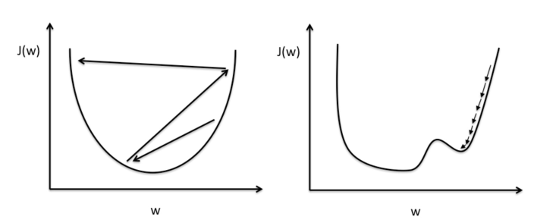
Picking 𝛼 - the learning rate
Too large: we “overshoot” and don’t converge to the global minima
Too small: the weights might not move far enough to reach a local minima, slow convergence
Notes:
So we have to pick the learning rate carefully, because we don’t want to overshoot, or undershoot. (Questions)

Slide 15

When you’re baking
You need 500g of flour.
Scenario 1:
You start by pouring A LOT of flour.
You are bold, and continue to pour a lot.
You accidentally pour too much. You then have to correct your error by removing the extra flour from your bowl.
Dreamstime

Slide 16
When you’re baking
You need 500g of flour.
Scenario 2:
You are scared that you would pour too much flour. Therefore, you pour a LITTLE at a time.
Once you were done. OOPSIE 3 hours have passed already.
You eventually got 500g of flour, yet it took you a really long time. Your cooking time was NOT optimized.
Dreamstime

Slide 17
When you’re baking
You need 500g of flour.
Scenario 3:
You start by pouring A LOT of flour every time.
As you get close to 500g. You start to slow down by pouring less flour at a time. You’re being careful not to go past it!
Once you are around 499.7g, you’re satisfied and you stop!
AMAZING
Dreamstime

Slide 18
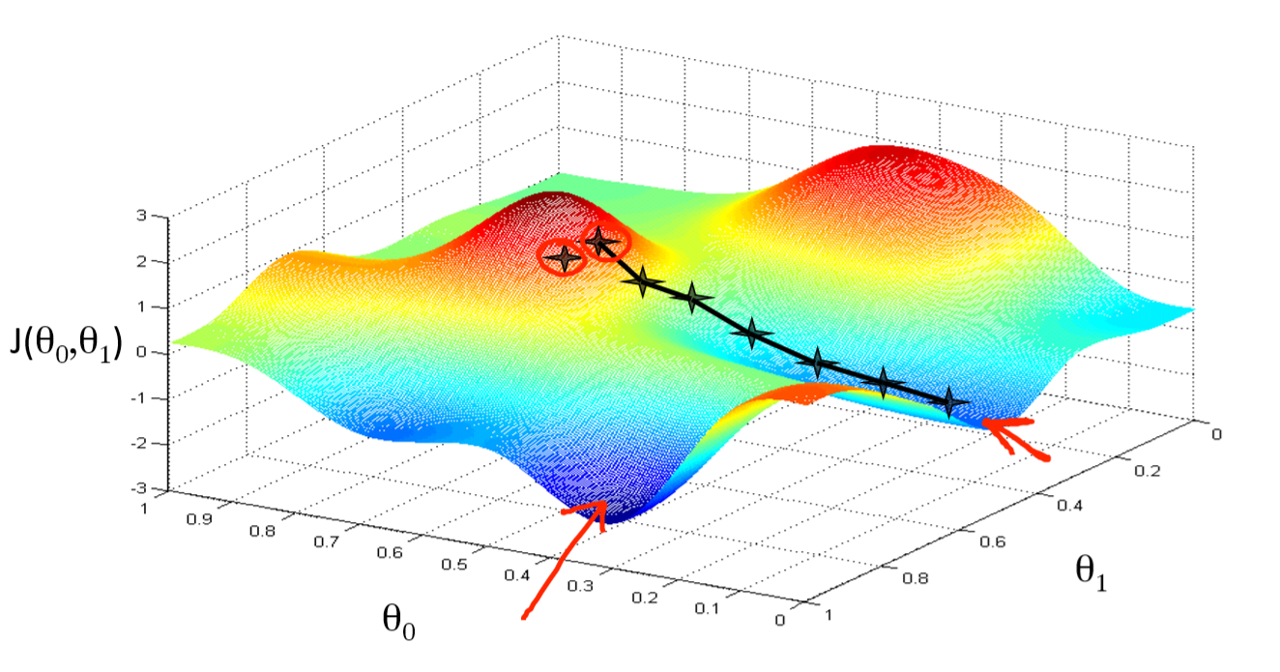
Gradient Descent
Notes:
There are many possible routes to the minimum point and many possible local minimas. Which means that depending on how you initialize your initial parameters, you may have different end results and you may or may not reach the global minima.

Slide 19
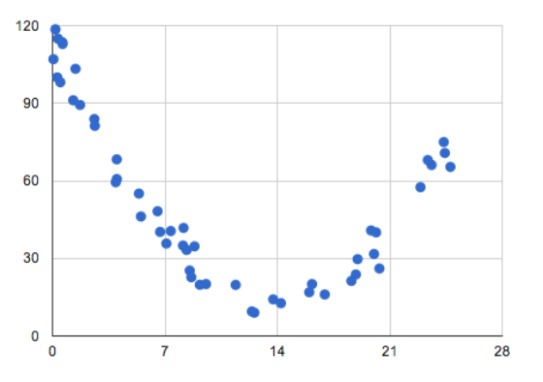
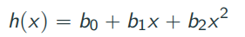
What if Data is Non-Linear?
Notes:
Ok, so what if our data is non-linear? Can we still use linear regression? (Slide)

Slide 20
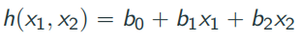
Introducing Polynomial Regression
We linearize our hypothesis h(x):
Such that x₁ = x, and x₂ = x^2
This way, the model is still linear with respect to its parameters.
:
Notes:
If we can somehow keep our model linear with respect to its weights, then yes!
We can extend this idea to higher order polynomials. (Slide)

Slide 21
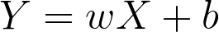
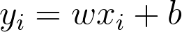
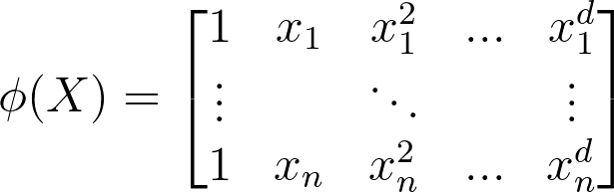
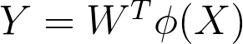
Introducing Polynomial Regression
Recall Linear Regression least square method:
For each sample
Now, find the best fit curve
For each sample
Notes:
So we can extend this idea of linearizing a function using what we call a polynomial basis! What this allows us to, from what we saw previously, is to keep our model linear with respect to its parameters!
𝝓(X) essentially provides a mapping from X to another space, such that parameters w are linear with respect to 𝝓(X) (Slide)
We now assume that our model is inherently a polynomial of degree d (as the mean of the Gaussian), with Gaussian noise to account for real-world practicalities.

Slide 22
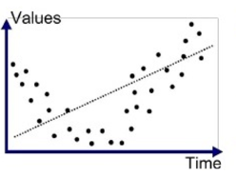
Overfitting vs. Underfitting
Underfitting: the model is not power / complex enough to properly fit complex dataset. It’s just too general.

Slide 23
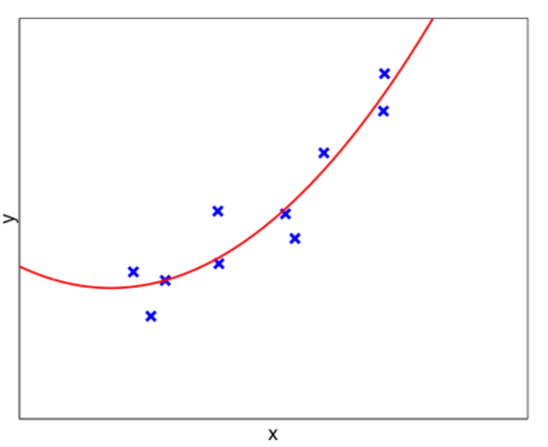
Order 2 fit

Slide 24
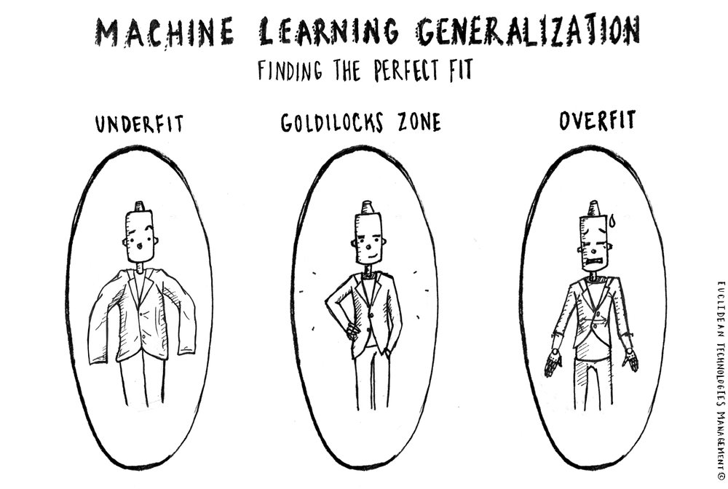
Overfitting vs. Underfitting
Underfitting: the model is not powerful / complex enough to properly fit complex dataset. It’s just too general.
Overfitting: the model is so adapted to the training set, that it cannot properly generalize and predict new inputs.

Slide 25
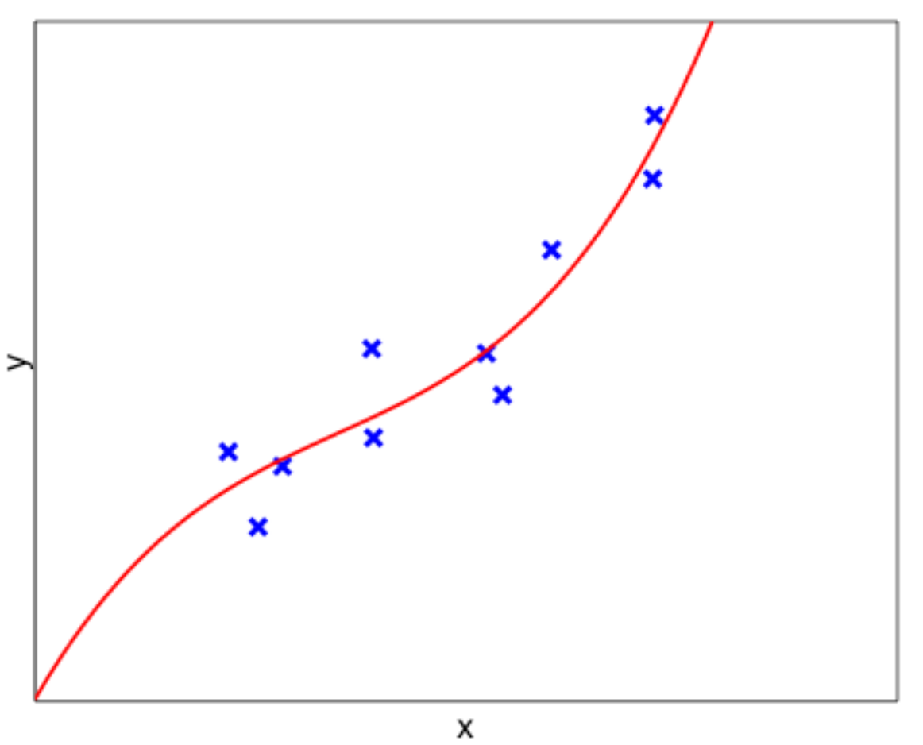
Order 3 fit

Slide 26
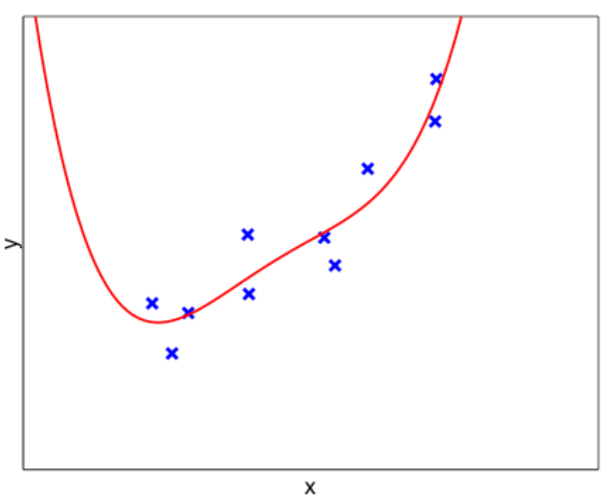
Order 4 fit

Slide 27
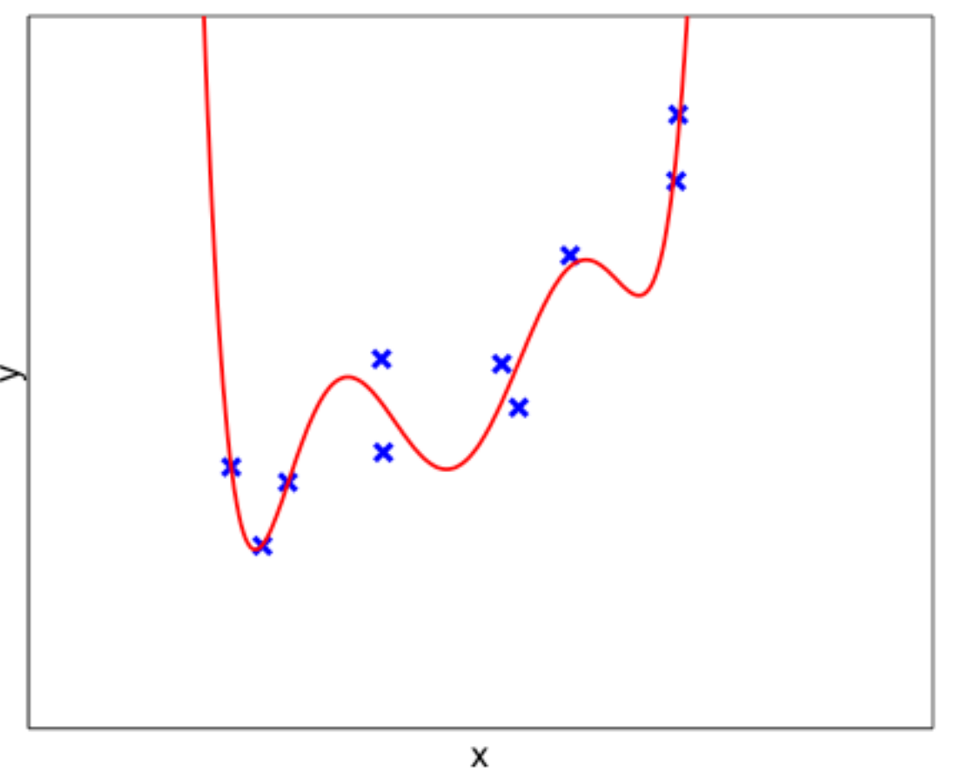
Order 6 fit

Slide 28
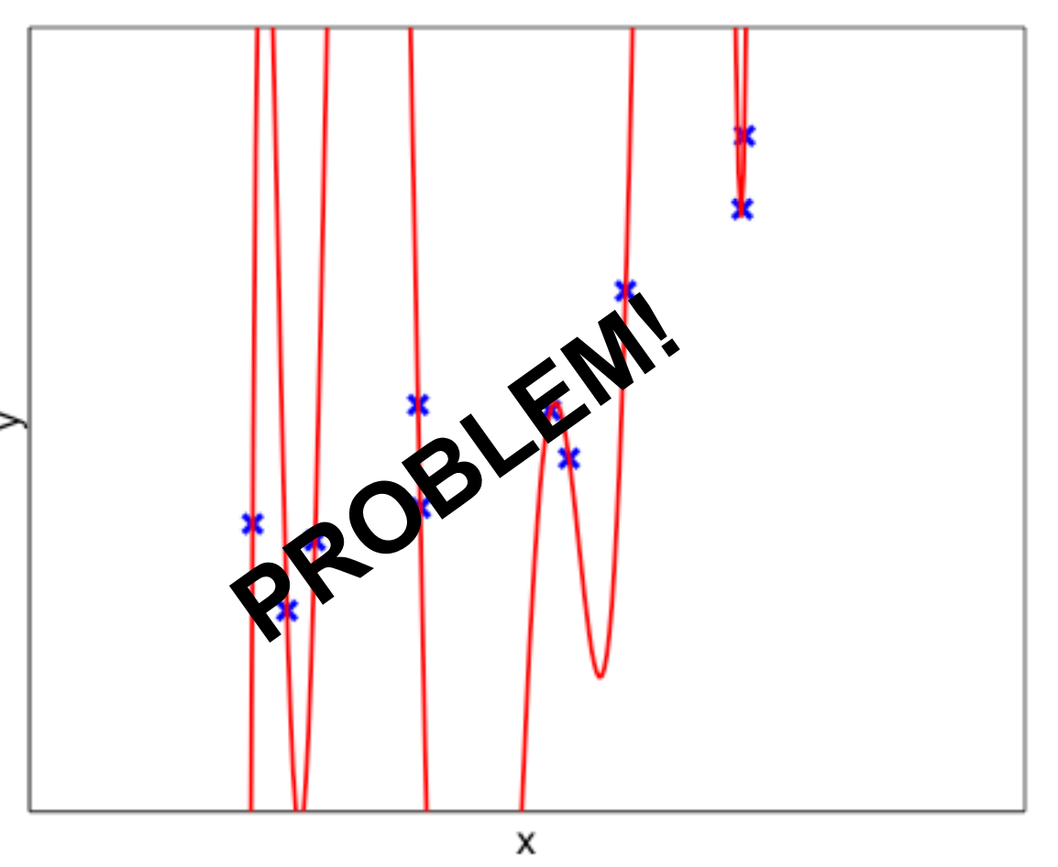
Order 9 fit

Slide 29
Addressing Overfitting
How to address overfitting:
Hyperparameter tuning
Simply modify hyperparameters that control the complexity of the model (in this case, the value of degree) until you get the validation set accuracy optimized
2) Adding more data
Adding more data, so simply having more training set data can allow for a more complex model without overfitting
More sophisticated methods: Ridge regression (L2 regularization), dropout in neural networks, lasso regression (L1 regularization), cross-validation, etc.
Notes:
There are many ways to address overfitting. The first is to simply modify hyperparameters that control the complexity of the model (in this case, the value of d) until you get the validation set accuracy optimized. Overfitting is also ameliorated by adding more data, so simply having more training set data can allow for a more complex model without overfitting There are many other techniques for regularization, However, we don’t have time to cover those in the time we have together, I recommend looking up Ridge Regression (equivalent to L2 regularization) - whose effect is numerically equivalent to dropout in neural networks, and lasso regression (equivalent to L1 regularization). Also, read up on more advanced techniques in cross validation (Slide)

Slide 30
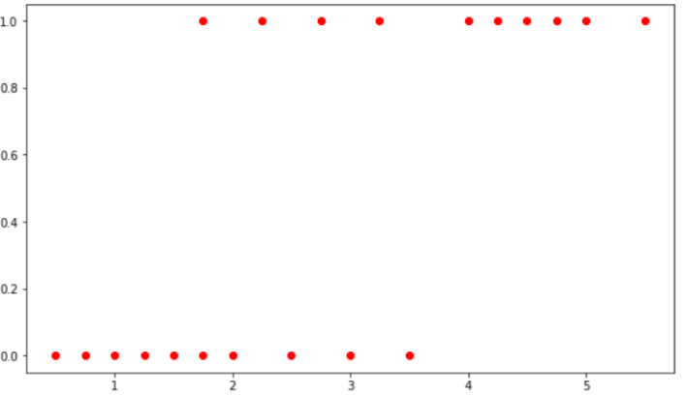
Now Consider the Following Problem...
Image credits to Berkeley DeCal Course
Notes:
ASK FOR BREAK
We’re now given the following dataset, which maps samples to either class 1 or class 0, e.g. spam or not-spam, given a certain feature space. Do you think we could use linear regression for this problem? (Ask questions)
No, since linear regression works on a continuous function space, whereas we only have two classes/ labels here. But, we could probably solve that in code using a rounding function, right?
What else is wrong? Anytime a straight line is fit to a binary response encoded as 0 or 1, we can always predict p(X) < 0 for some X, and p(X) > 1 for others… (Slide)

Slide 31
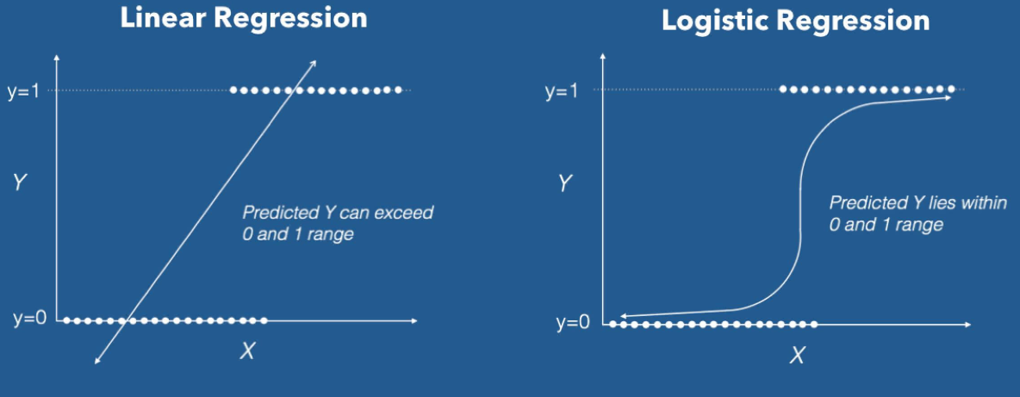
Why Linear Regression Doesn’t Work Here
Image Credits
Logistic regression predicts the probability that an input belongs to a certain class.
Notes:
In order to guarantee that our prediction lies in between 0 and 1, we need to pick a model that is not linear! This is where logistic regression comes in. We use what we call a “logistic” function, shown on the slide, to threshold between the two classes. (Slide)

Slide 32
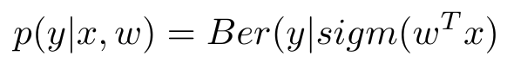
Logistic Regression
Instead of modeling our response directly, logistic regression models the probability that y belongs to a certain class:
Bernoulli, sigmoid… what are those??
Notes:
Logistic Regression is actually a classification model that maps a linear model that best fits a set of data points, where we use a thresholding function called a sigmoid function to determine which class each data point should be. What does it look like?
Example of Bernoulli random variable: coin flip, we have two outcomes, if the coin is fair, draw the PDF of Bernoulli
Sigmoid: the logistic function to
(Slide)

Slide 33
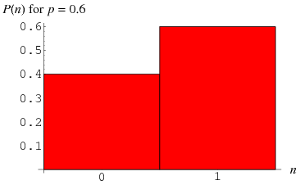
Bernoulli Random Variable
Total probability = 1
p(success) = 0.6
p(failure) = 1- 0.6 = 0.4
Notes:
Example of Bernoulli random variable: Coin toss

Slide 34
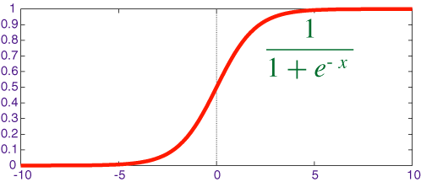
Sigmoid/ Logistic Function
We want a function f s.t. range(f ) ϵ [0, 1] ∀ X
Probability interpretation
Notes:
What problem does the sigmoid function solve, that we’ve encountered with linear regression when trying to classify our dataset using an affine model?
We model p(X) using a function s.t. range(f) is between [0,1] for any X.
What does p(X) represent? p(X) represents the possibility of a sample belonging to class y = 1.
Let’s manipulate the function a little… (Slide)

Slide 35
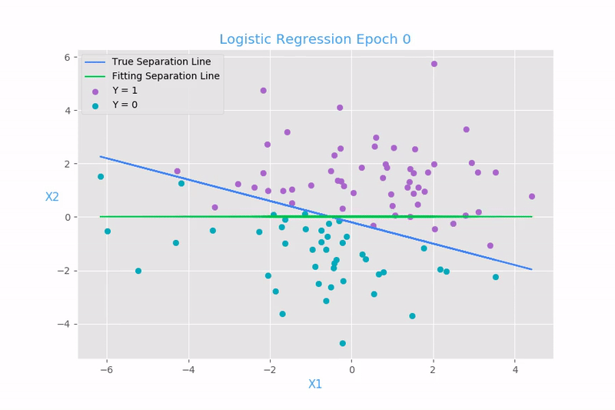
What is Logistic Regression

Slide 36
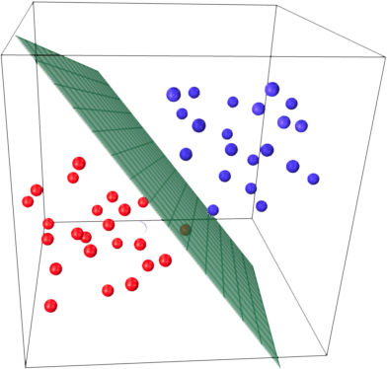
How does Logistic Regression work?
Green plane
How likely is a point blue?
Blue dots:
Very likely
P(X) = (0.5, 1)
Red dots:
Very unlikely
P(X) = (0, 0.5)
On the Green plane:
Equally blue and red
P(X) = 0.5
(source)

Slide 37
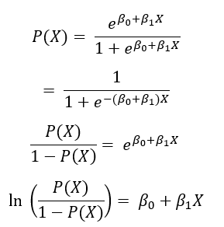
Logistic Function (Ct’d)
The “logit/ log-odds” function is linear in X
Notes:
Recall that in the linear regression model, increasing X by one unit would increase f(X) by β1. In the logistic regression model, increasing X by one unit would increase the logit, or log-odds function by β1.

Slide 38
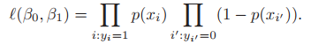
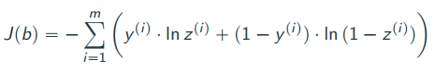
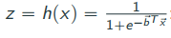
Computing Regression Coefficients
Although we can use the least-squares method and estimate using our training data, we prefer the maximum likelihood approach due to its better statistical properties (out of the scope of the course).
We seek to minimize logistic loss:
Notes:
So what are we looking for? Basically, we’re looking for Beta1 and Beta naught such that plugging in those estimates would cause our logistic function to yield results close to 1 for all samples of class 1, and results close to 0 for all samples of class 0. We thus define a logistic loss function that we seek to minimize. We won’t be going over the derivations, but if you want we can talk about it during office hours
Notes: z is the sigmoid function that we described earlier, and describes the probability of sample i of belonging to class 1, here we take the log likelihood
y_{i} is such that only one of the two terms is “active” for a given sample.
What does it look like? (Slide)

Slide 39
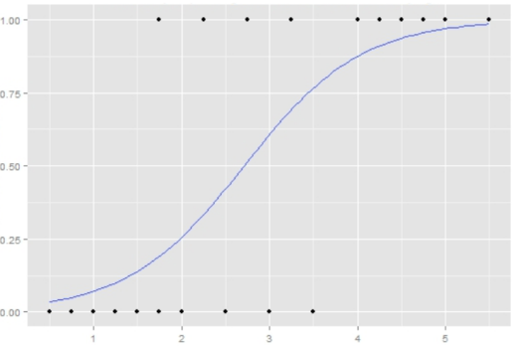
Coefficients should return something like this...
Notes:
Hence, we have defined a linear decision boundary on the log-odds function, P(X)/1-P(X).

Slide 40
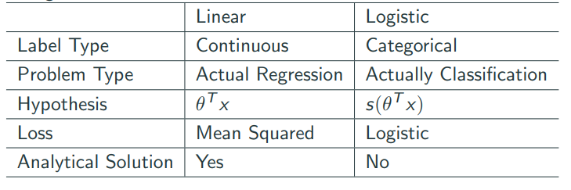
SUMMARY
Hello friend

Slide 41
Homework Assignment
Implementing linear regression.
Assignment4-LinearRegression.ipynb
Notes:
https://www.w3resource.com/python-exercises/numpy/linear-algebra/numpy-linear-algebra-exercise-1.php
Read up on eigenvectors and eigenvalues

Slide 42
Thanks!
Any questions?
McGill Artificial
Intelligence Society

